Slide 1

Integrating Adobe Firefly with Brand AI Chatbot
A Strategic Approach for Luminar
James Laughlin – Adobe Inc.

Slide 2
Understanding Luminar’s Needs

Slide 3

Understanding Luminar’s Needs
Key needs:
On-brand text/image/video generation
Secure and scalable AI integration
Elegant integration with existing/proposed systems
Key challenges:
Understanding the current AI architecture
Documenting all proposed requirements
Integrating Adobe’s AI tools with internal APIs, systems & any third-party solutions
Training the business on use of new AI tools

Slide 4
Overview of Firefly Services APIs

Slide 5
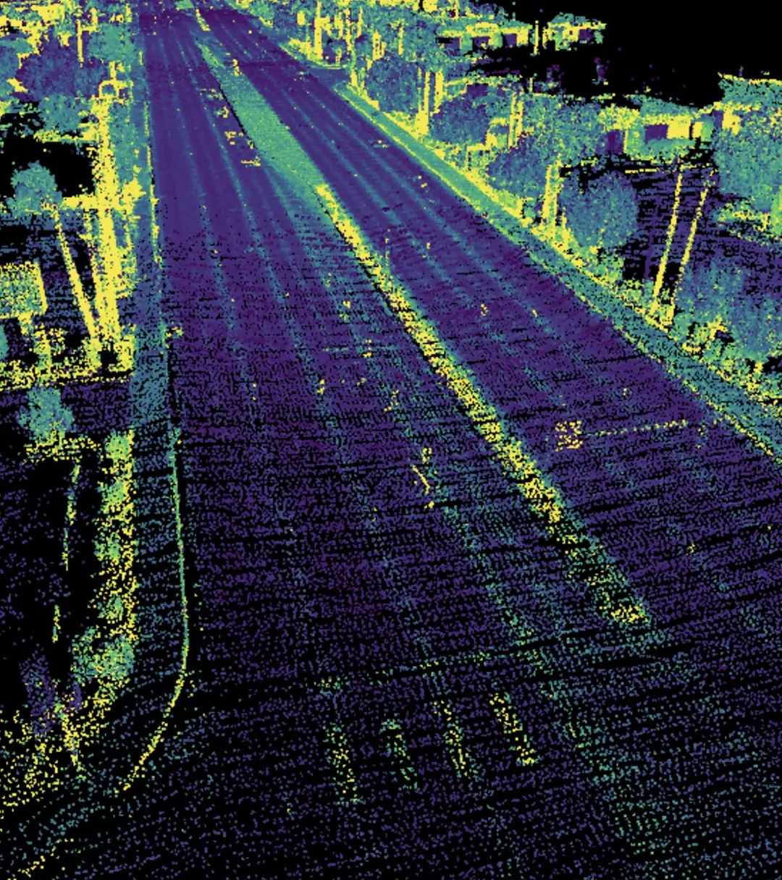
Overview of Firefly Services APIs
Firefly APIs enable image, vector, and template generation aligned with brand styles and voice.
Supports reference image styling and prompt-based content creation.
Ideal for automation, dynamic content, and branded asset/copy production.
Key capabilities: text-to-image, generative fill, template remixing, copy generation.
Seamless integration with Adobe Express, AEM, and Creative Cloud assets.

Slide 6
Proposed Architecture & API Management

Slide 7

Proposed Architecture & API Management
AI Chatbot → Internal API Gateway → Firefly Services & LLMs.
Custom API gateway allows routing, throttling, and observability.
Incorporates Adobe Express/AEM for content deployment.
Security: OAuth2, Adobe Identity integration, third-party SSO, rate limiting.
Scalable via containerized microservices or serverless (e.g., AWS Lambda, Azure Functions).

Slide 8
Integration Strategy & Validation

Slide 9

Integration Strategy & Validation
Phase 0: Information gathering and documentation of requirements

Slide 10
Integration Strategy & Validation
Phase 0: Information gathering and documentation of requirements
Phase 1: PoC with Firefly API (image generation) and prompt engineering.

Slide 11
Integration Strategy & Validation
Phase 0: Information gathering and documentation of requirements
Phase 1: PoC with Firefly API (image generation) and prompt engineering.
Phase 2: Connect chatbot with internal gateway to route AI tasks.

Slide 12
Integration Strategy & Validation
Phase 0: Information gathering and documentation of requirements
Phase 1: PoC with Firefly API (image generation) and prompt engineering.
Phase 2: Connect chatbot with internal gateway to route AI tasks.
Phase 3: Integrate LLM for on-brand text via fine-tuning or guardrails.

Slide 13
Integration Strategy & Validation
Phase 0: Information gathering and documentation of requirements
Phase 1: PoC with Firefly API (image generation) and prompt engineering.
Phase 2: Connect chatbot with internal gateway to route AI tasks.
Phase 3: Integrate LLM for on-brand text via fine-tuning or guardrails.
Phase 4: UI development and integration with existing interface.

Slide 14
Integration Strategy & Validation
Phase 0: Information gathering and documentation of requirements
Phase 1: PoC with Firefly API (image generation) and prompt engineering.
Phase 2: Connect chatbot with internal gateway to route AI tasks.
Phase 3: Integrate LLM for on-brand text via fine-tuning or guardrails.
Phase 4: UI development and integration with existing interface.
Validation: brand review, stakeholder feedback, performance tests.

Slide 15
Maintenance & Scaling Considerations

Slide 16

Maintenance & Scaling Considerations
Automated testing pipelines for API and model updates.
Version control and fallbacks for Firefly APIs.
Monitoring via API gateway and usage dashboards.
Scalable storage for assets, caching strategies for high-demand prompts.
Plan for feedback loops to refine prompt engineering continuously.

Slide 17
Closer Slide

Slide 18
Things I’d like to have done better

Slide 19
Things I’d like to have done better
Additional routes in the code to:
Generate images from a sample
Demo generative fill capabilities
Generate on-brand copy from a sample image
Include a feedback feature so that Firefly can learn from what I’m seeing
“more like this”
“that child’s eyes are not closed”

